Slide 1

Machine Learning
Live slideshow project
Sergio Sánchez García
Pablo Santos Blázquez

Slide 2


What is the project about?
Neural Network build from scratch that can classify live movements for controlling a slideshow

Slide 3
Execution steps
01
Data acquisition
04
Validation
Obtain CSV files from recorded videos
Check if the model is valid and accurate
02
Preprocess
Live mode
05
Compute the data to fit as the NN input
Control the slideshow with live gestures
03
Training
06
Test mode
Apply optimization to obtain a valid model
Calculate the score of our trained model

Slide 4
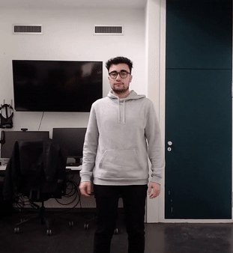


01
Data acquisition

Slide 5

02
Preprocess

Slide 6
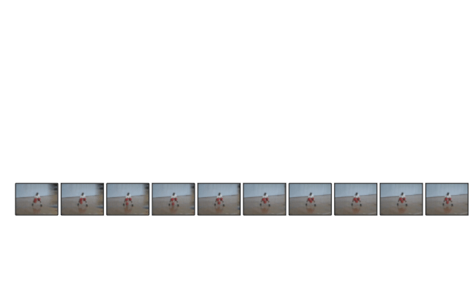
02
Preprocess

Slide 7
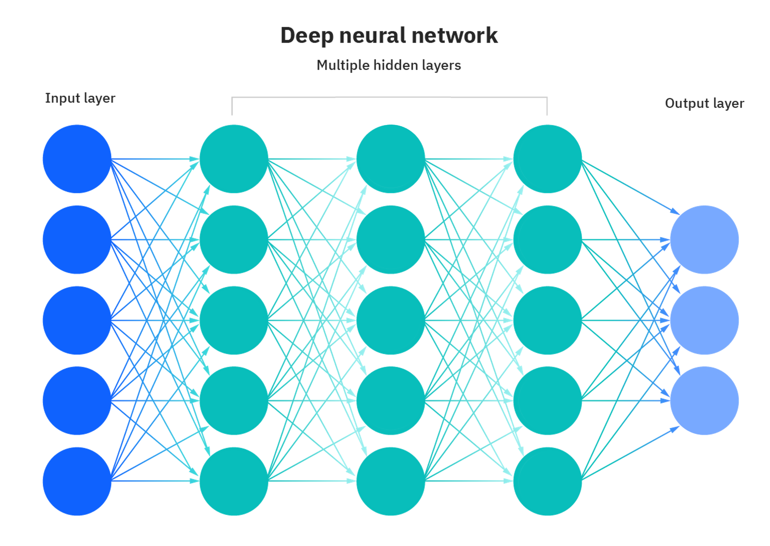
03
Training
39x Frames
24x Variables
ReLU
ReLU
Softmax
936
936
256
128
8
len(Movements)

Slide 8
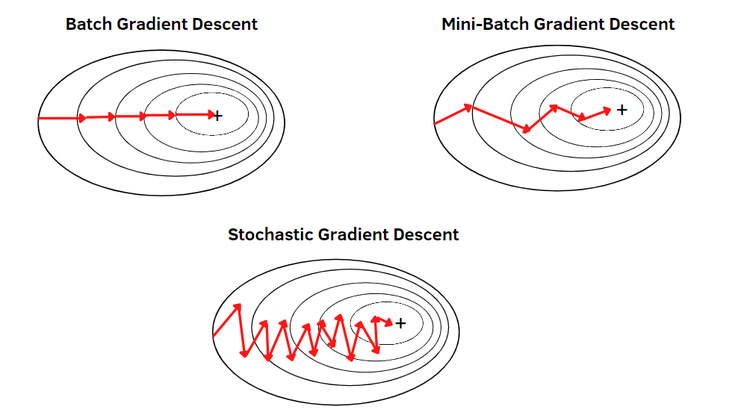
03
Training

Slide 9
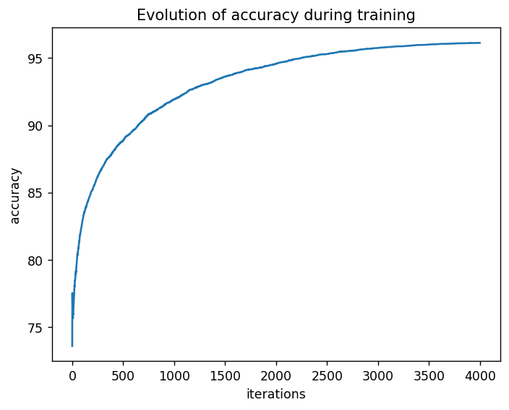
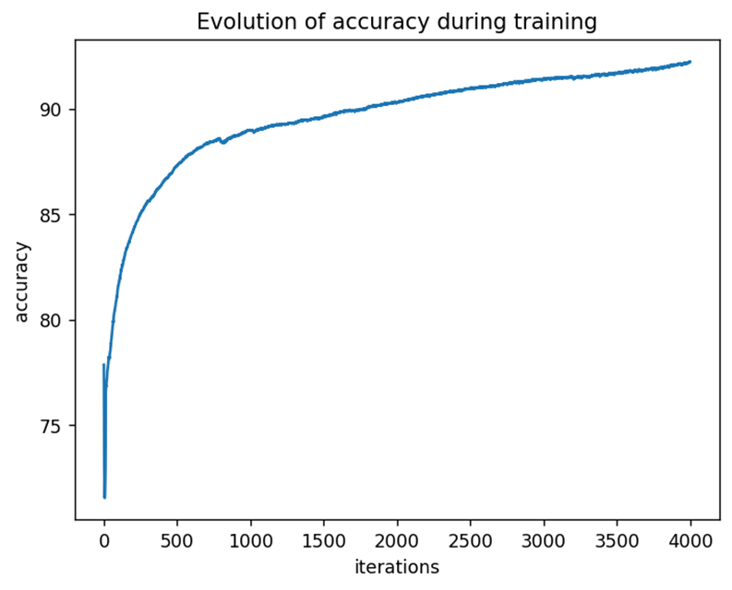
04
Batch size
Validation
256
128

Slide 10
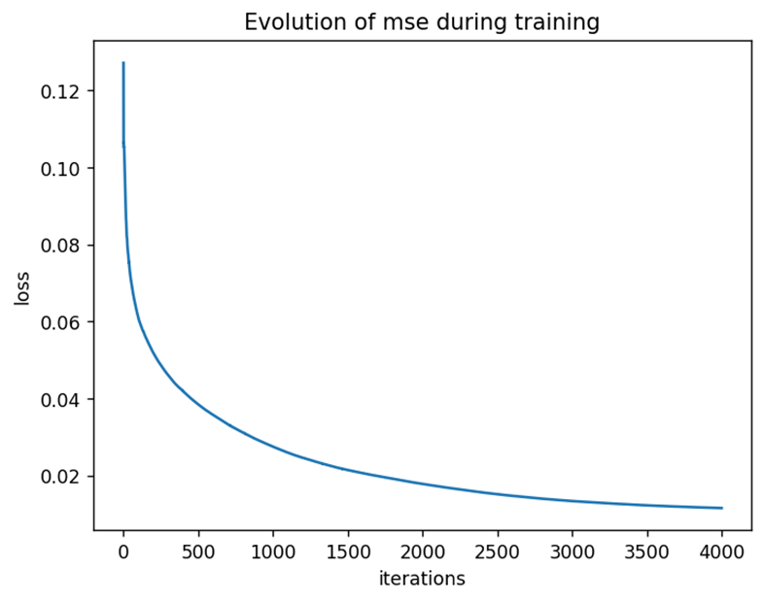
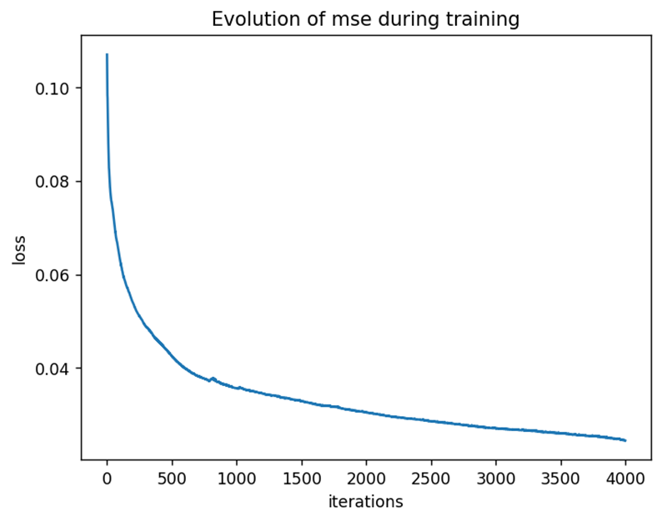
04
Batch size
Validation
256
128

Slide 11
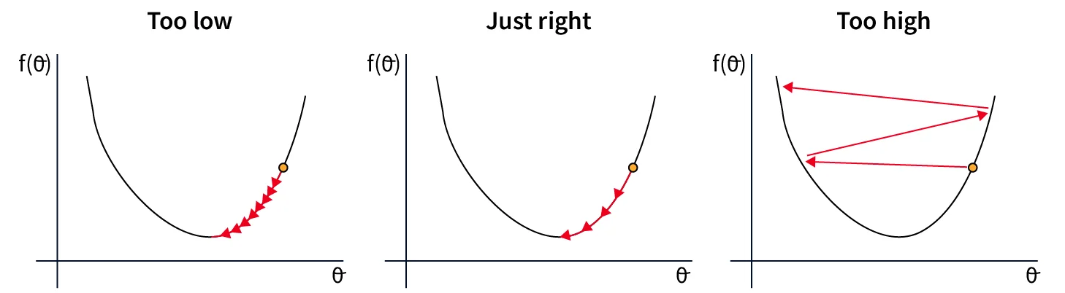
04
Validation
Learning rate
0.001
0.01
0.1

Slide 12
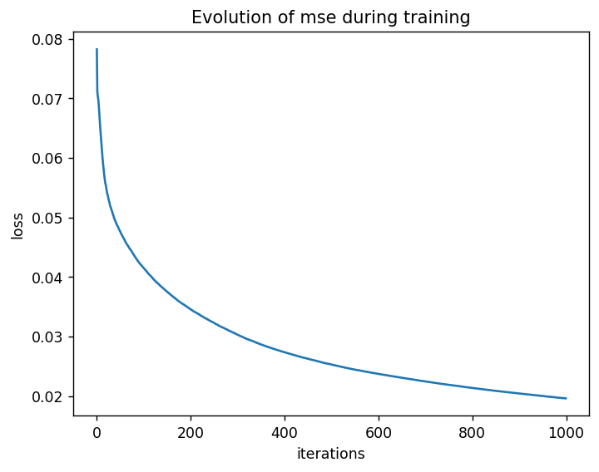

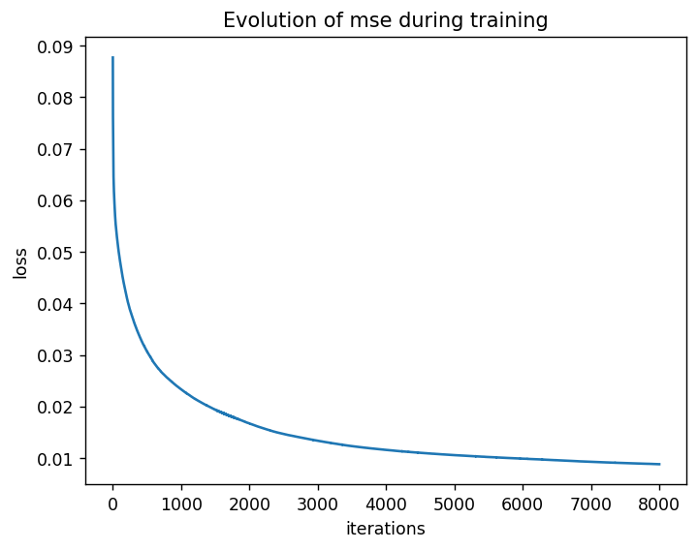
04
Iterations
Validation
1000
4000
8000

Slide 13
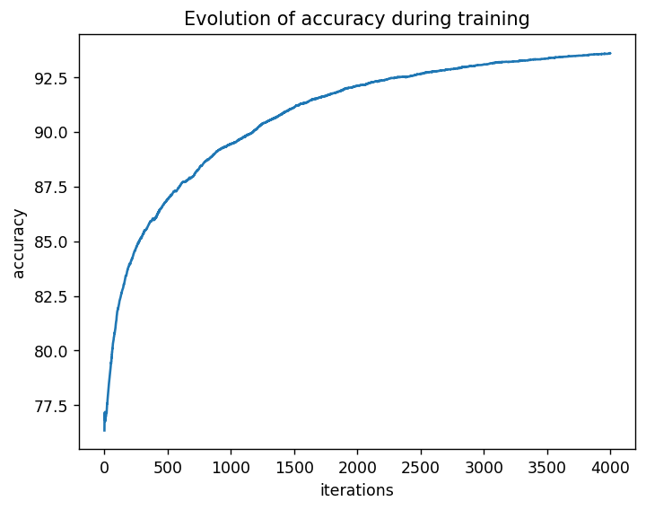
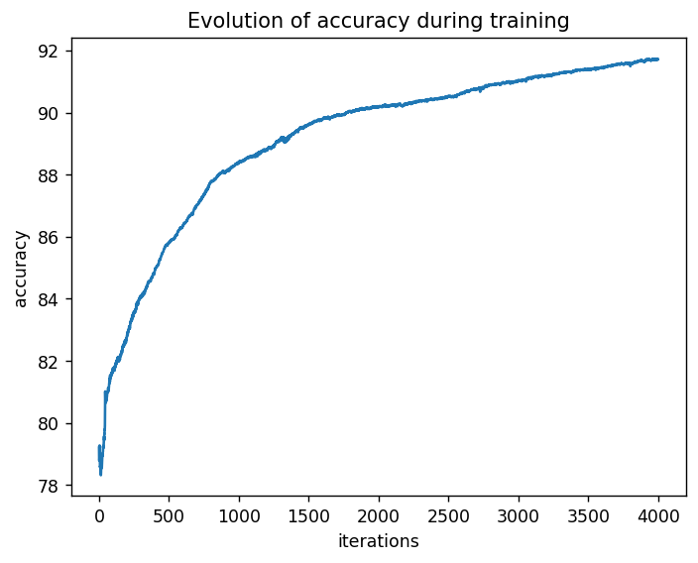
04
Hidden layers size
Validation
First hidden layer: 128
Second hidden layer: 64
First hidden layer: 256
Second hidden layer: 128
First hidden layer:512
Second hidden layer: 126

Slide 14
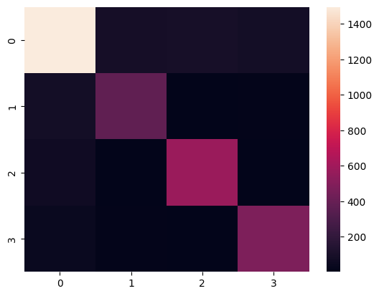
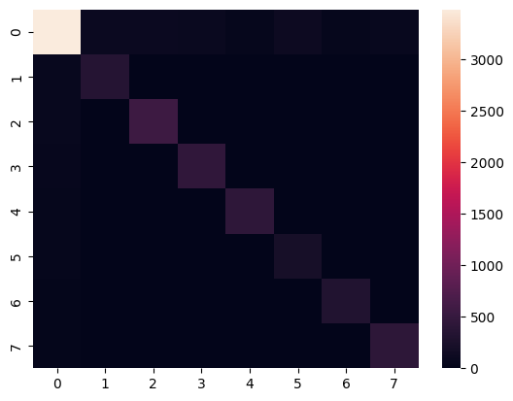
04
Confusion Matrix
Validation
Mandatory moves
Mandatory + optional moves

Slide 15

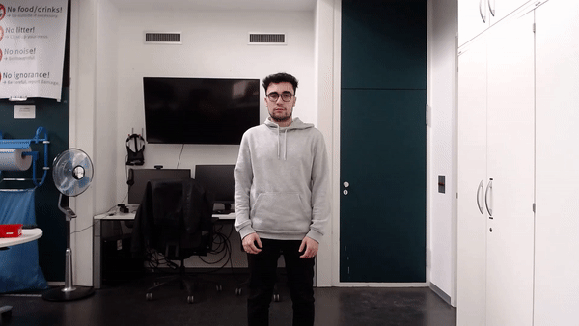

05
Mandatory movements
Live mode
Rotate
Swipe_right
Swipe_left

Slide 16
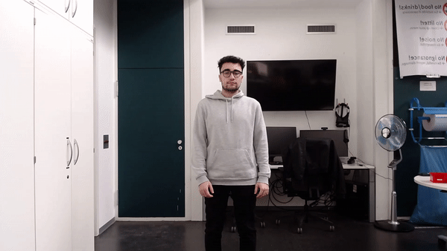
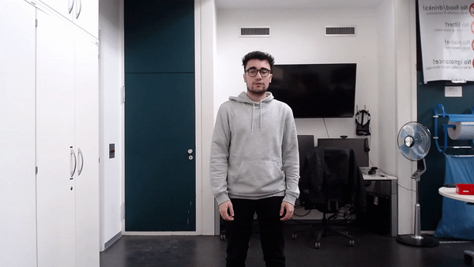
05
Optional movements (I)
Live mode
Rotate_left
Table_flip

Slide 17
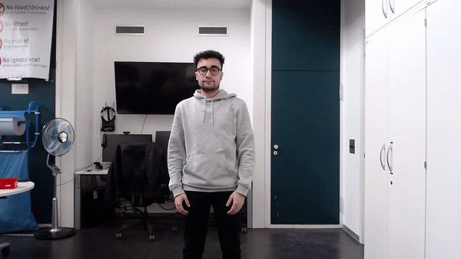

05
Optional movements (II)
Live mode
Zoom_in
Zoom_out

Slide 18


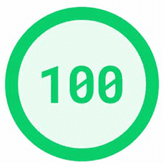
06
Test mode
events.csv
7_calculator.py
ground_truth.csv
Performance score
Input data

Slide 19

Questions

